Slide 1


Slide 2
External Entity Attack (XXE)

Slide 3

Contents:
What is XML
What is XXE
Different Attack types of XXE
How to find XXE in attack surfaces
Live Practical example

Slide 4
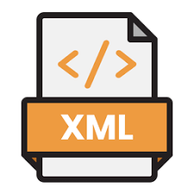
What is XML…?
Extensible markup language(XML) is a standard for exchanging structured data in textual format
XML was designed to store and transport data
XML does not have pre-defined tag
XML simplifies data transport
XML simplifies data availability
XML DTD (Document Type Definition) defines structure,element and attribute of xml body.

Slide 5
XXE(External Entity Attack)
XML external entity injection (also known as XXE) is a web security vulnerability that allows an attacker to interfere with an application's processing of XML data
XXE payloads interact with any back-end or external systems that the application itself can access.

Slide 6
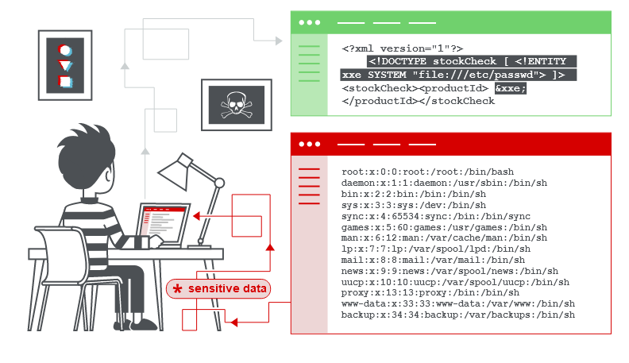
It allows an attacker to view files on the application server filesystem, and to interact with any back-end or external systems that the application itself can access.

Slide 7
Different Attack Types of XXE
Retrieving system files;
SSRF;
DOS;

Slide 8

How to Find XXE
To perform an XXE injection attack , we need to modify the submitted XML
Consider below XML for checking the stock of a product

Slide 9

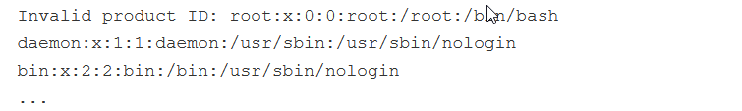
Attacker modifies existing XML body to retrieve internal server file
Which later could result in display of /etc/passwd file in response body

Slide 10
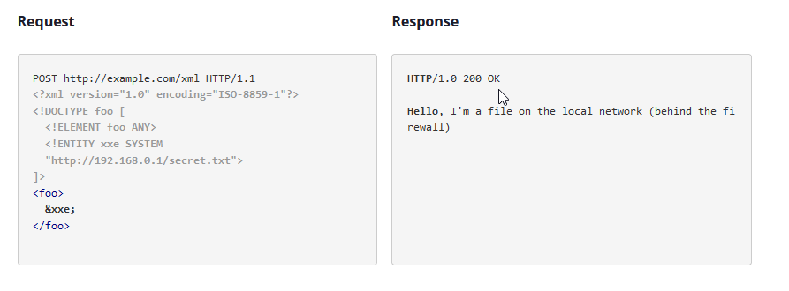
XXE could be used to read different server internal files as well

Slide 11
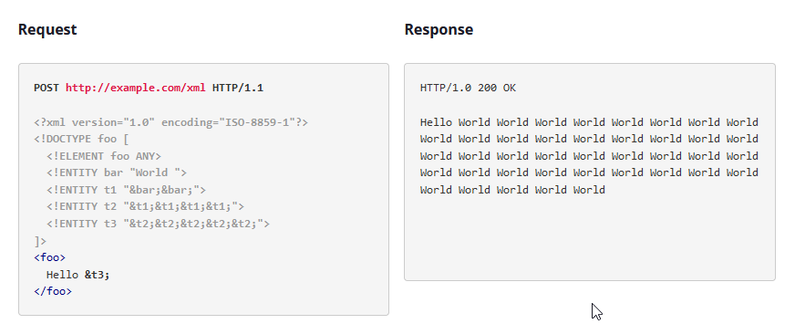
Billion Laughs attack which results in DOS by calling entity within entity within entity

Slide 12
Payloads cheatsheet:-https://github.com/swisskyrepo/PayloadsAllTheThings/blob/master/XXE%20Injection/README.md
https://github.com/omurugur/XXE_Payload_List

Slide 13
Thank you

